Slide 1
Fintendo Game Studio Production Management DB
Hannah Smith

Slide 2
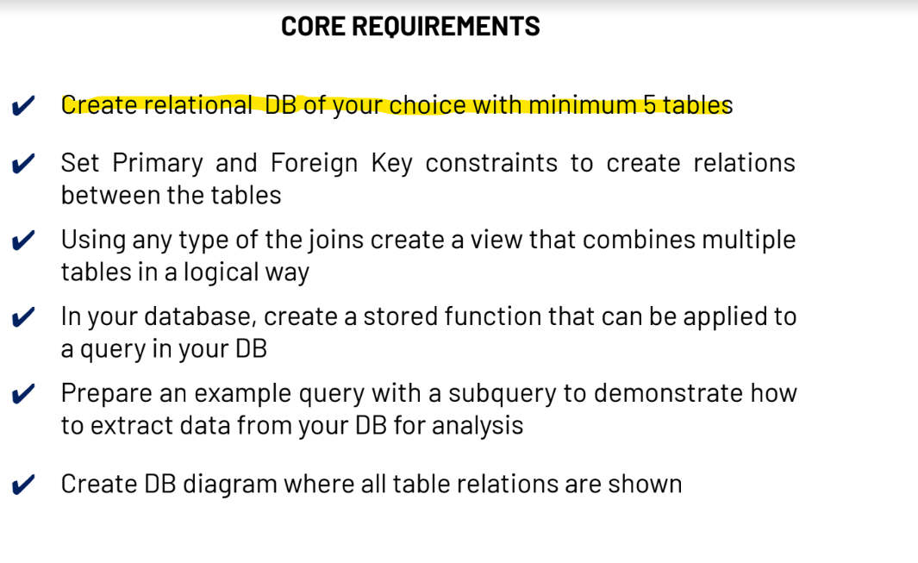

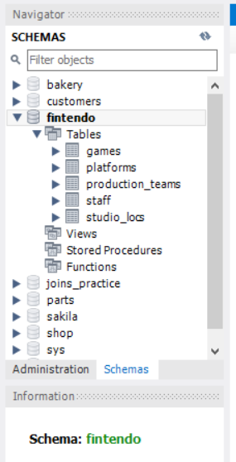

Slide 3
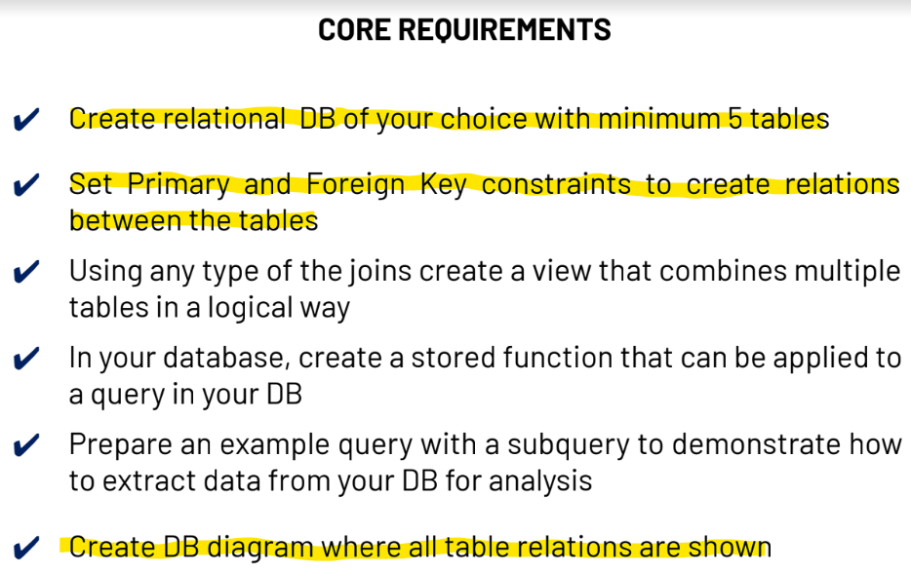
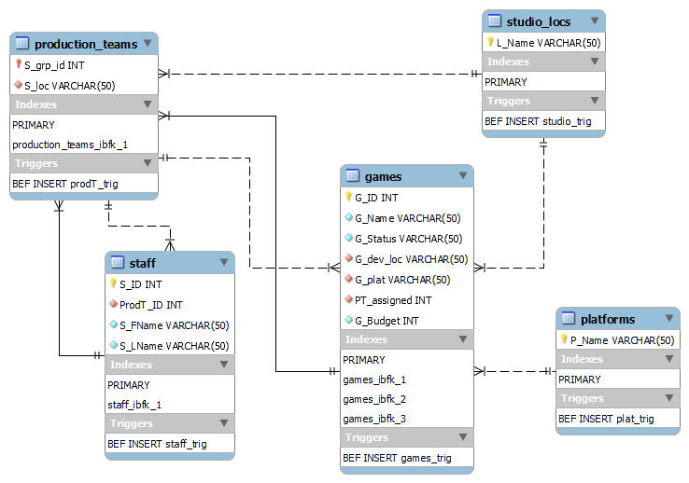
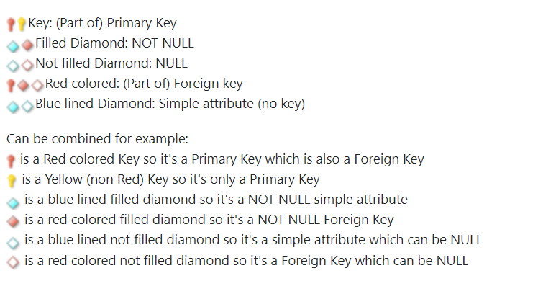

Slide 4
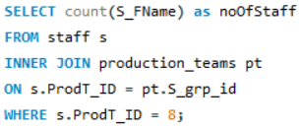

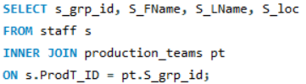
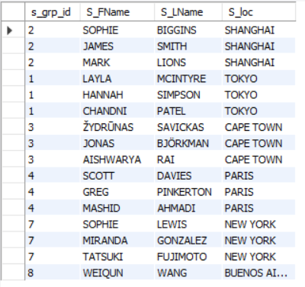
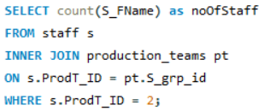

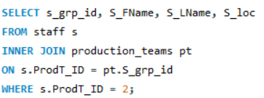
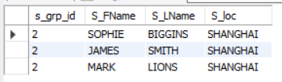

We’d like to know how many members of staff are on different production teams – so that we can shuffle teams around if they have too many/too few members. We can do:
We’d also like to know the names and location of staff who are on different production teams – so that the business can get an overview of how our personnel resources are spread out across the globe. Therefore we can do:

Slide 5
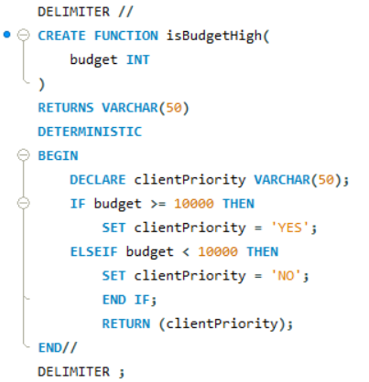
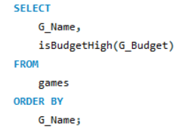
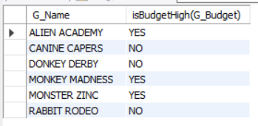

Some games will have a higher budget than others, and Fintendo gives the clients funding these high budget games a higher priority when it comes to assigning production efforts. Using a stored function, we can easily view the games that need to be prioritised. We can do:

Slide 6
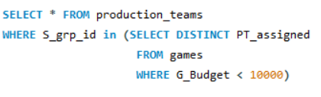
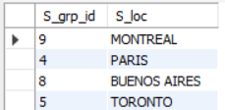
Using a nested query, we can see the ID and location of production teams working on games with a budget under 10,000. See as follows:

Slide 7

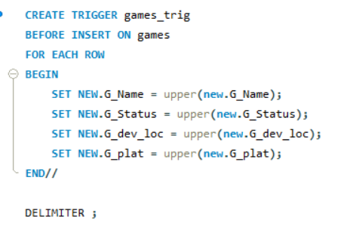
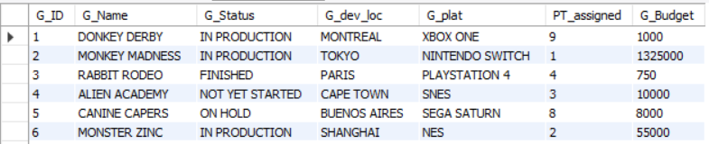

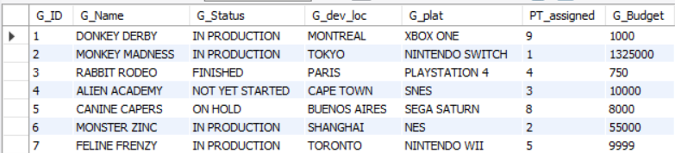
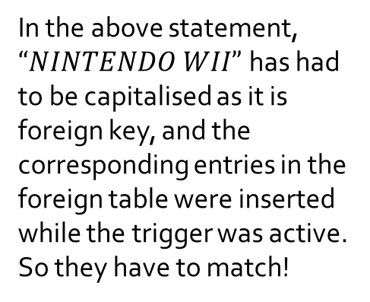
Advanced Requirements
This trigger was added before a lot of the core requirements, as I felt it was important to populate the database with data in uppercase letters. This ensures that strings are clear and easy to read. See below:
BEFORE
AFTER
In the above statement,
$“NINTENDO WII”$has had to be capitalised as it is foreign key, and the corresponding entries in the foreign table were inserted while the trigger was active. So they have to match!

Slide 8
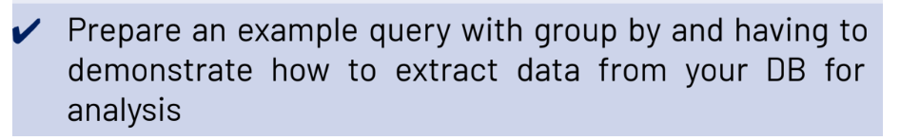
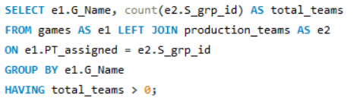
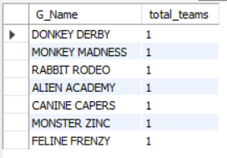
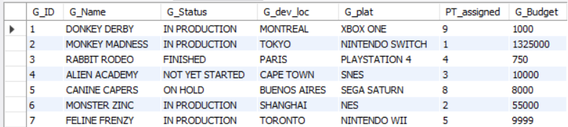
This query shows the names of games that are being worked on and the total number of teams working on them. See below:
Interestingly, this query would actually be more informative if my database was designed a different way. Taking for example the game Donkey Derby, the total number of teams as “total_teams” could be any number, however the relationship between games and production is 1:1; so I am unable to insert any more data on this game. The G_ID is a PK and is already value 1. I would not be able to add another team to PT_assigned, and have another team work on it.

Slide 9
Thanks All!

